Slide 1
IPL
VISUALISATION
Project
Presentation
29 June 2024
ADITYA KIRTANE

Slide 2

Content
01 Match Statistics
02 Player Statistics
Toss outcome vs Match outcome
Biggest wins by runs
Biggest wins by wickets
Highest totals (across all the seasons)
Orange Cap contenders
Purple Cap contenders
Batsmen who have hit the most number of
4s and 6s
03 Team Statistics
Season-wise team performance (wins vs losses)
Win %age (home vs away)

Slide 3
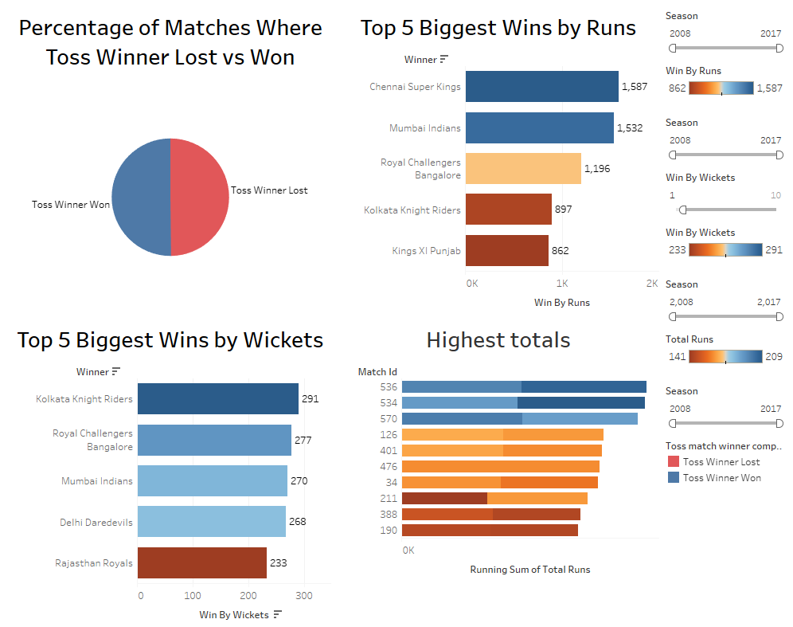
Match Statistics

Slide 4
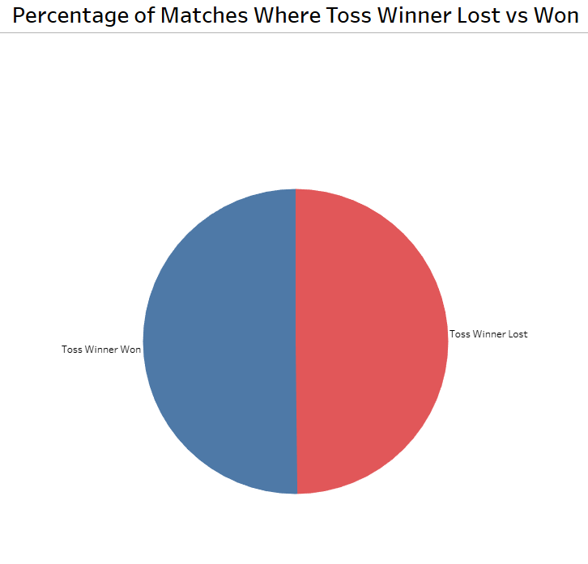
Toss outcome vs Match outcome
50.17% of Toss winners won the match
49.82% of Toss winners lost the match
50.17%
49.82%
Next Slide

Slide 5
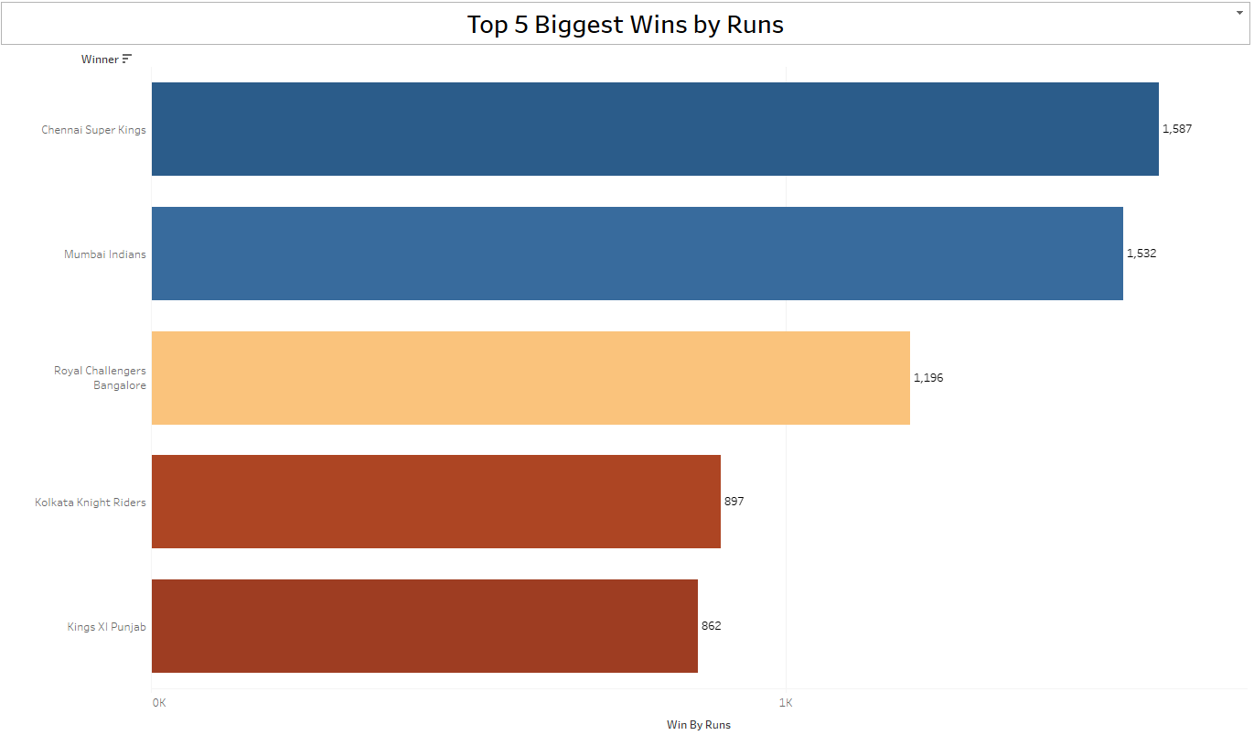
Biggest wins by runs
Top 5 wins:
Chennai Super Kings (1587 runs)
Mumbai Indians (1532 runs)
Royal Challengers Bangalore (1196 runs)
Kolkata Knight Riders (897 runs)
Kings XI Punjab (862 runs)
Insight: Chennai Super Kings and Mumbai Indians have demonstrated the ability to win by large margins, indicating their batting strength.
Next Slide

Slide 6
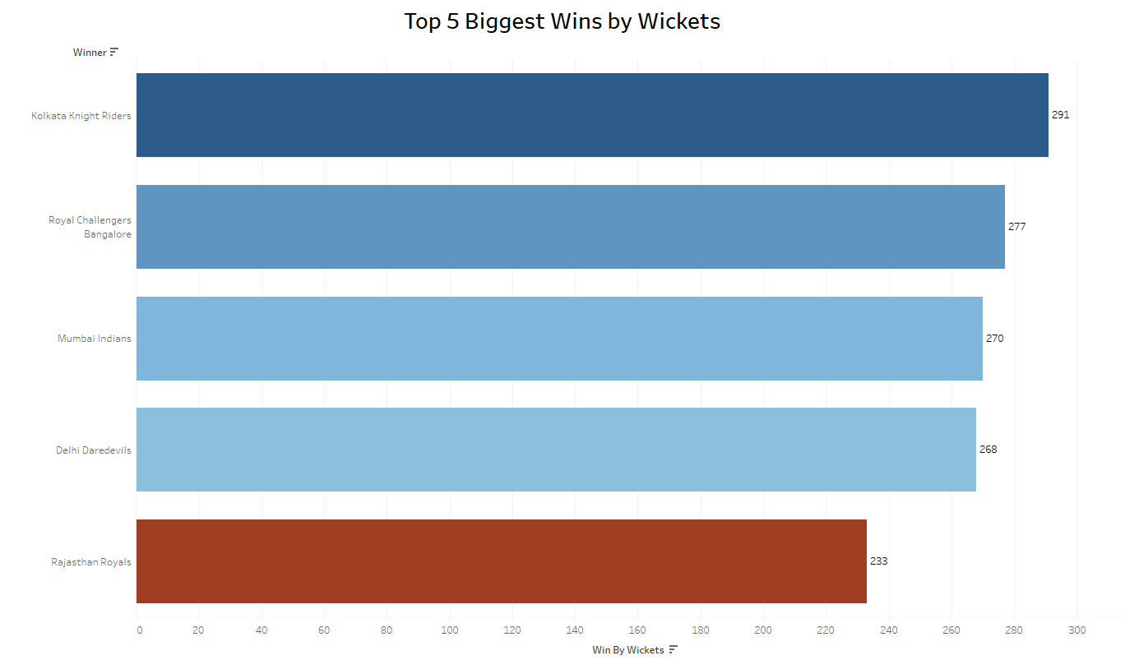
Biggest wins by wicket
Top 5:
Kolkata Knight Riders (291 wickets)
Royal Challengers Bangalore (277 wickets)
Mumbai Indians (270 wickets)
Delhi Daredevils (268 wickets)
Rajasthan Royals (233 wickets)
Insight: Kolkata Knight Riders have shown strong bowling performances, winning matches by taking the most wickets.
Next Slide

Slide 7
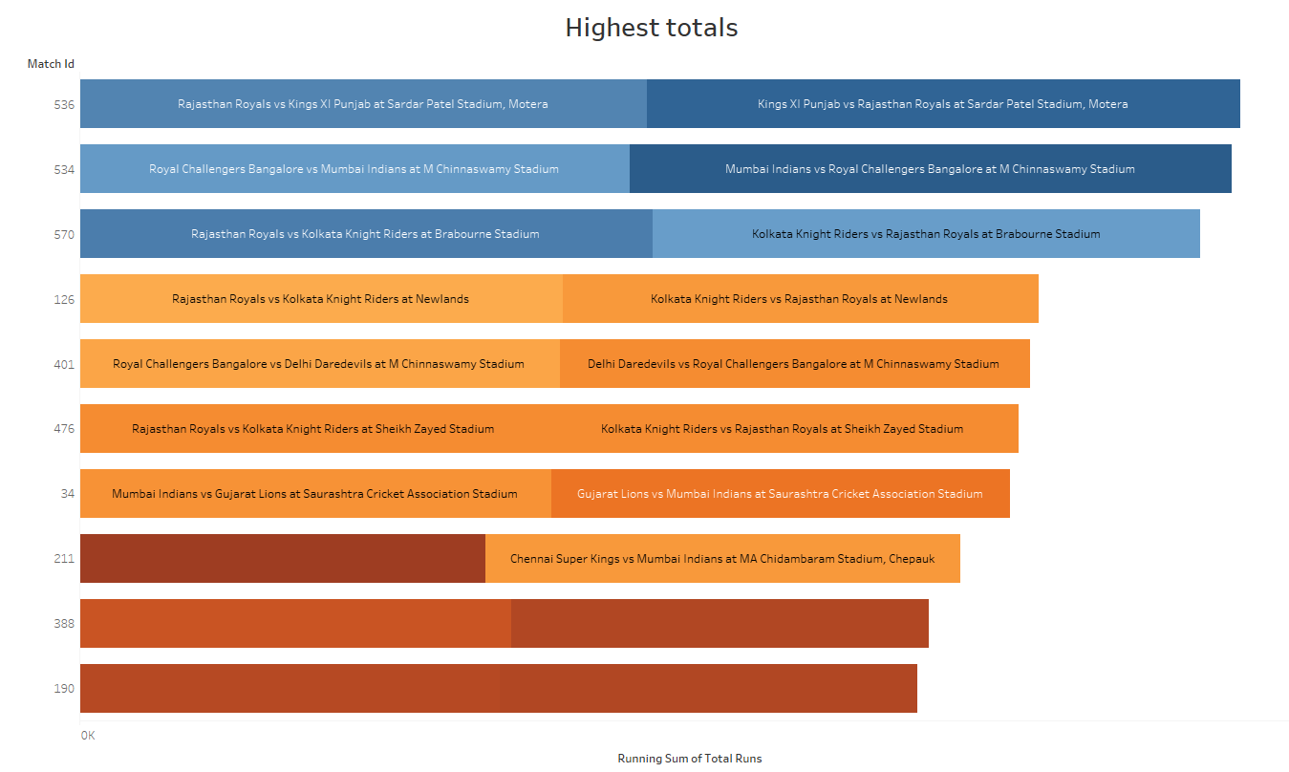
Highest totals
Highest: Rajasthan Royals vs Kings XI Punjab at Sardar Patel Stadium, Motera Insight: This match showcased exceptional batting performance and potentially challenging bowling conditions.
Next Slide

Slide 8
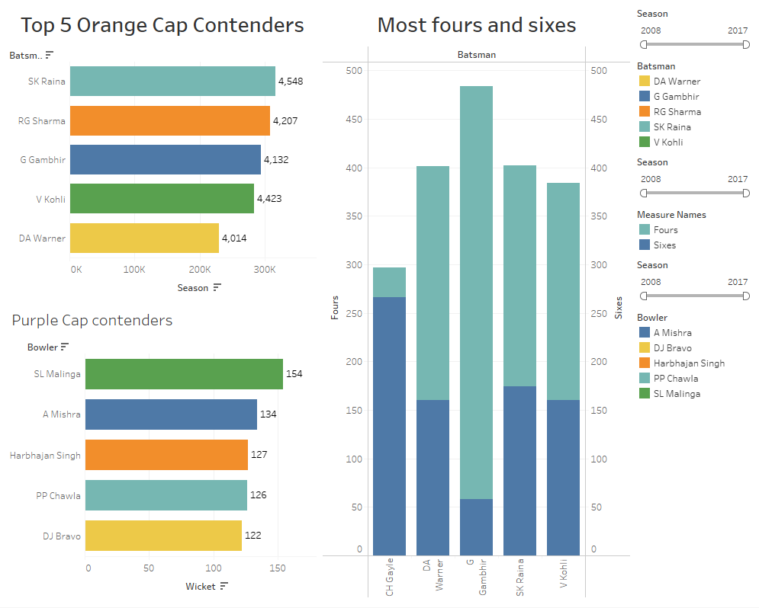
Player Statistics

Slide 9
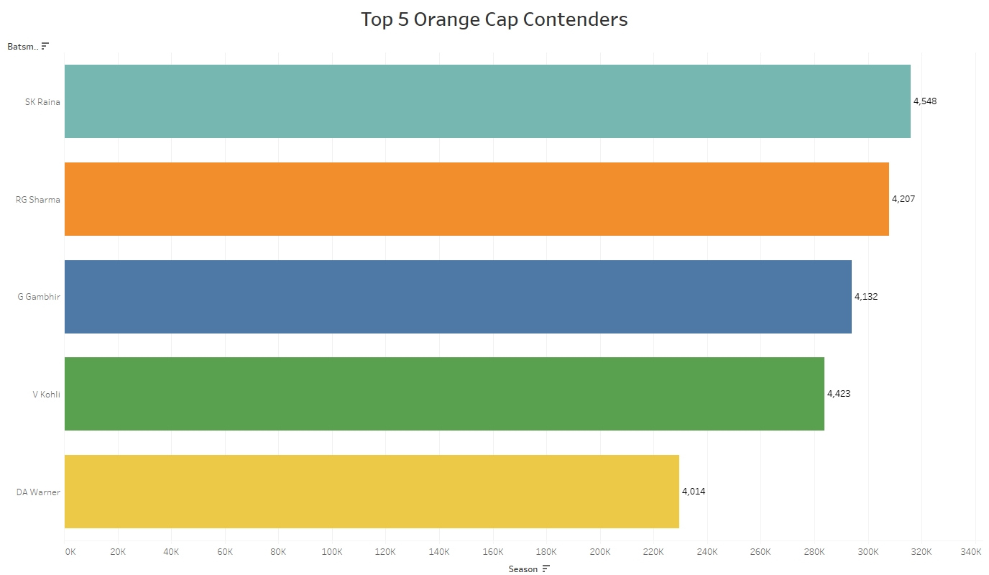
Orange Cap contenders
Top 5:
SK Raina
RG Sharma
G Gambhir
V Kohli
DA Warner
Insight: These players have consistently been top run-scorers across seasons, demonstrating their batting prowess in the T20 format.
Next Slide

Slide 10
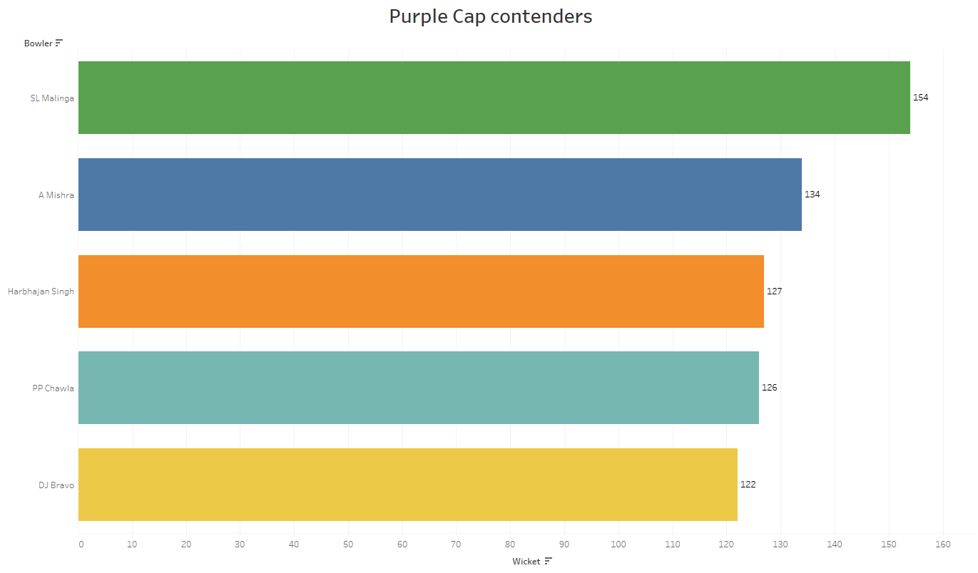
Purple Cap contenders
Top 5:
SL Malinga
A Mishra
Harbhajan Singh
PP Chawla
DJ Bravo
Insight: A mix of pace and spin bowlers dominate the top wicket-takers list, showing the importance of varied bowling attacks in IPL.
Next Slide

Slide 11
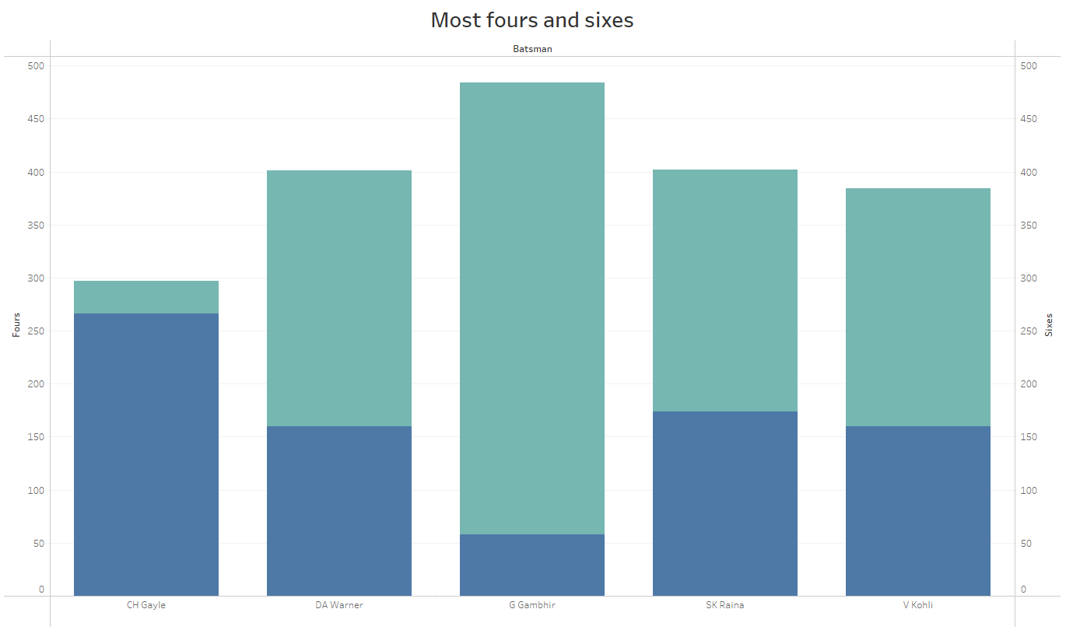
Batsmen who have hit the most number of fours and sixes
Overall leader: G Gambhir Insight: Gambhir's ability to hit boundaries consistently has made him a valuable asset in the T20 format.
Next Slide

Slide 12
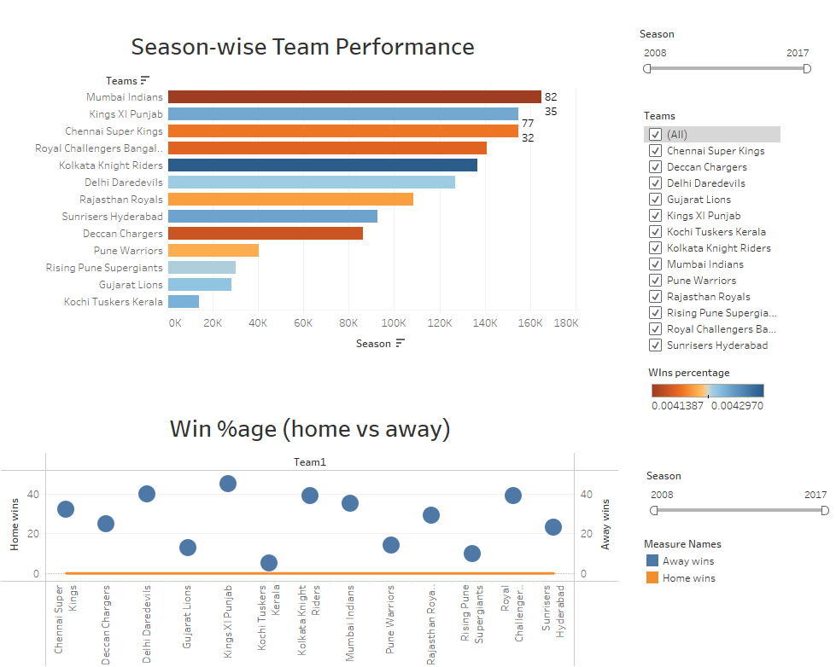
Team Statistics

Slide 13
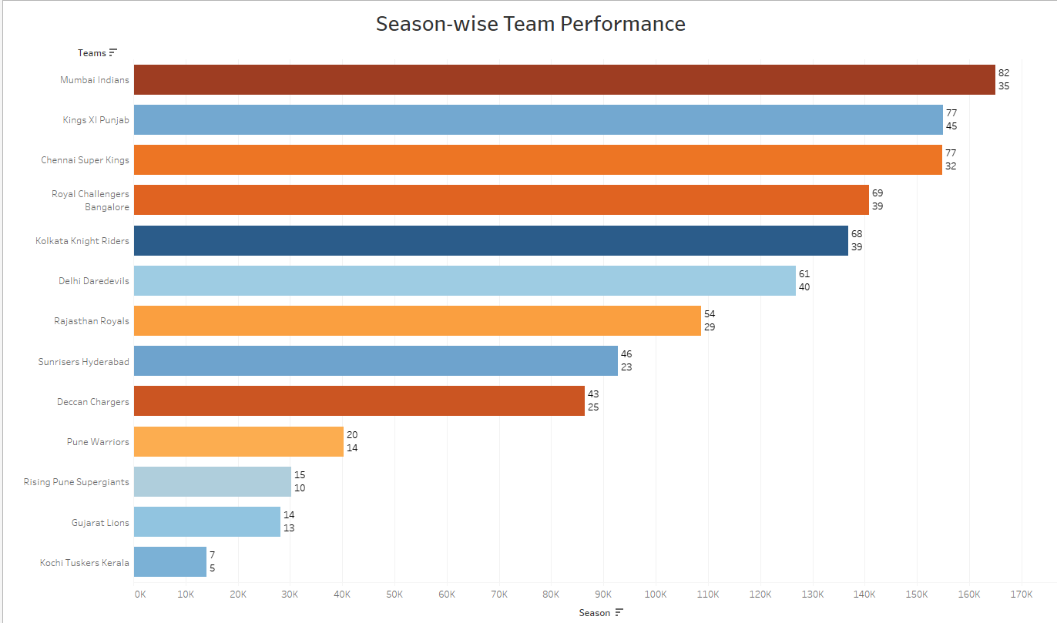
Season-wise team performance
Highlight: Mumbai Indians with 82 wins and 35 losses overall Insight: Mumbai Indians have shown consistent performance across seasons, maintaining a high win-loss ratio.
Next Slide

Slide 14
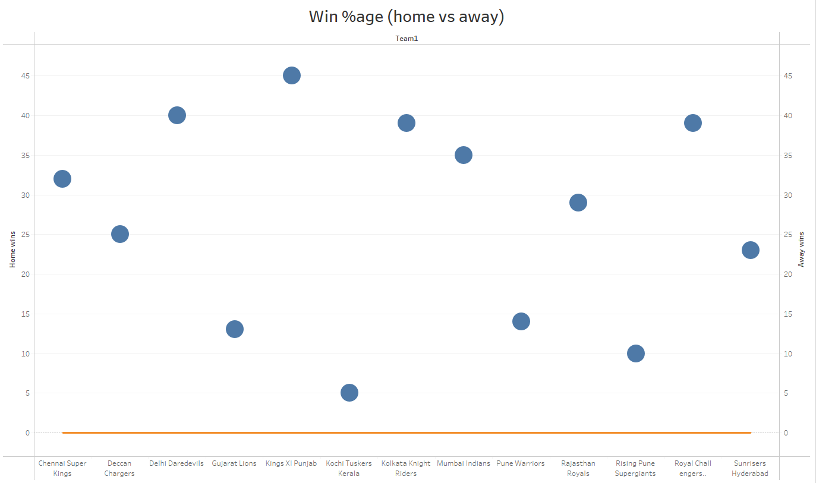
Win %age (home vs away)
Home: 0%
Away: 100%
Insight: This unusual statistic needs further investigation. It could indicate data anomalies or a unique situation where teams performed exceptionally well in away games.
Next Slide

Slide 15
Thank You.
Project
Presentation
29 June 2024
ADITYA KIRTANE

